Slide 1
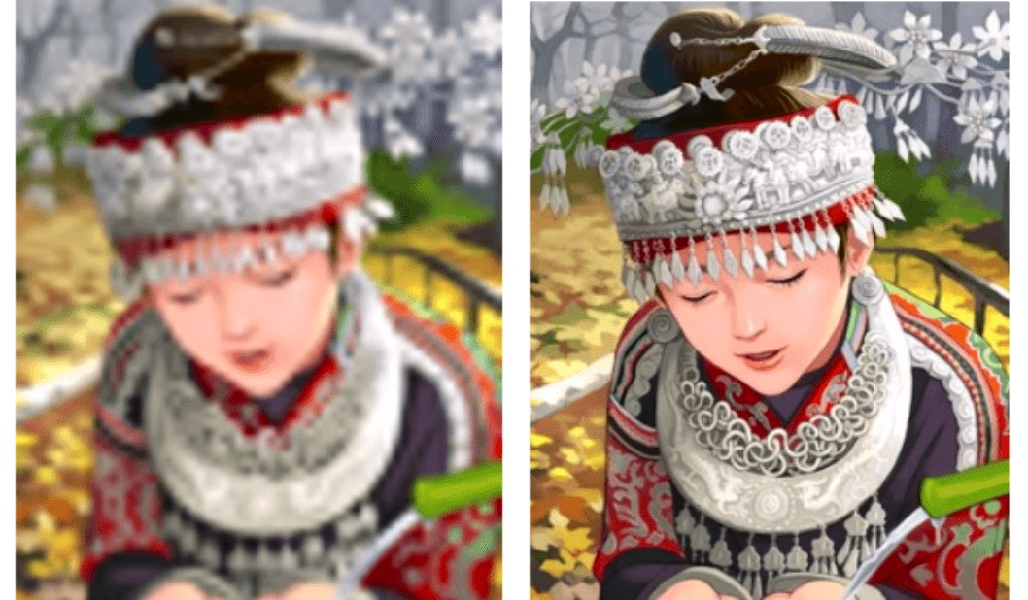
Super Resolution of Images/Videos using SRGAN
Srikanth Babu Mandru

Slide 2
Overview
Problem Statement
Data
SRGAN Model
Training and deployment details
Results

Slide 3
Business Problem
Super-Resolution of video footages
Particularly, faces

Slide 4
Project goals
Generate super-resolution image from low-resolution image
Using Generative Adversarial Networks ( SRGAN )
Super resolution of video footage

Slide 5
Data
Image datasets:
DIV2K [ DIV2k Dataset link]
MS-COCO [ MS-COCO Dataset Link ]
Training data : 5800 images , Validation Images: 100 images
Video datasets :
Vid4 [ Vid4 Dataset Link ] - for video super-resolution
For Inferences :
LFW: LFW dataset
Set5 and Set14: Set5 & Set14 Datasets
Reference: Nao Takano and Gita Alaghband. “SRGAN: Training Dataset Matters”, 2019. ( arXiv:1903.09922 ).

Slide 6
Image preprocessing
Original images are (2048, 1080, 3) shape
Crop images to (96, 96, 3) (reduced)
Discriminator input is (96, 96, 3) – High Resolution
Generator input is (24, 24, 3) – Low Resolution
Images are downsampled using "bicubic" kernel by a factor of “4"

Slide 7
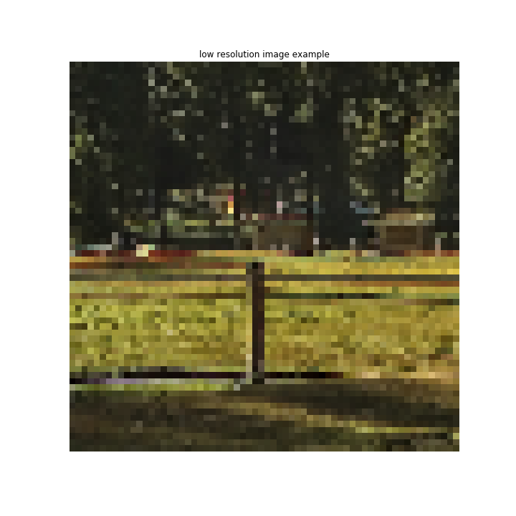
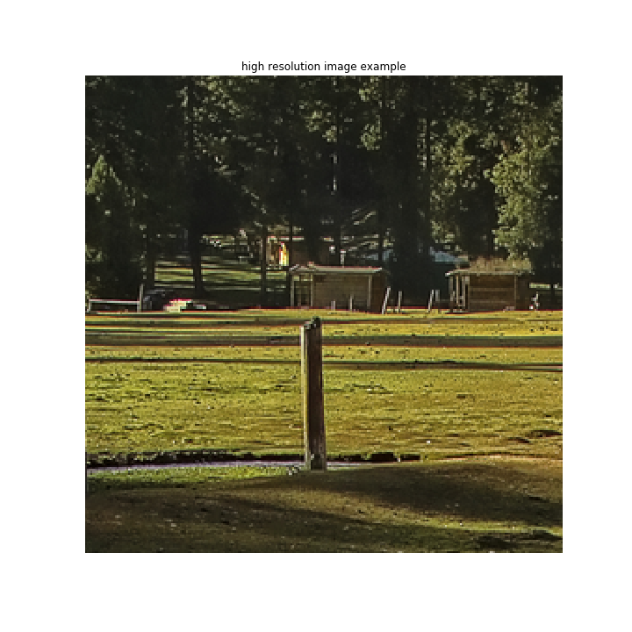
Image preprocessing
Low resolution image
High resolution image

Slide 8
SRGAN Model details
SRGAN is specific type of GAN architecture
Uses unique loss “perceptual loss” for generator training

Slide 9
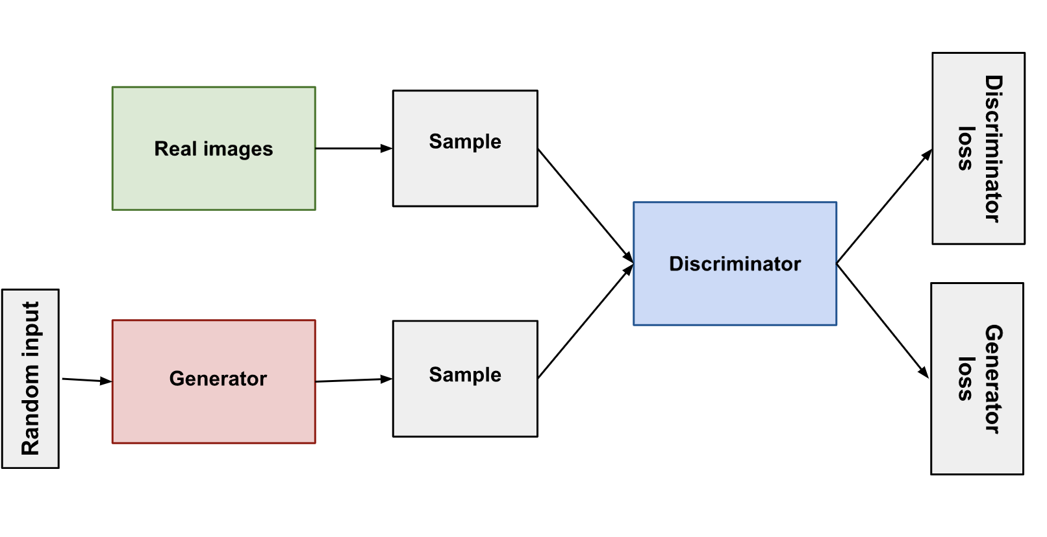
Generative Adversarial Networks (GAN)
GAN block diagram

Slide 10
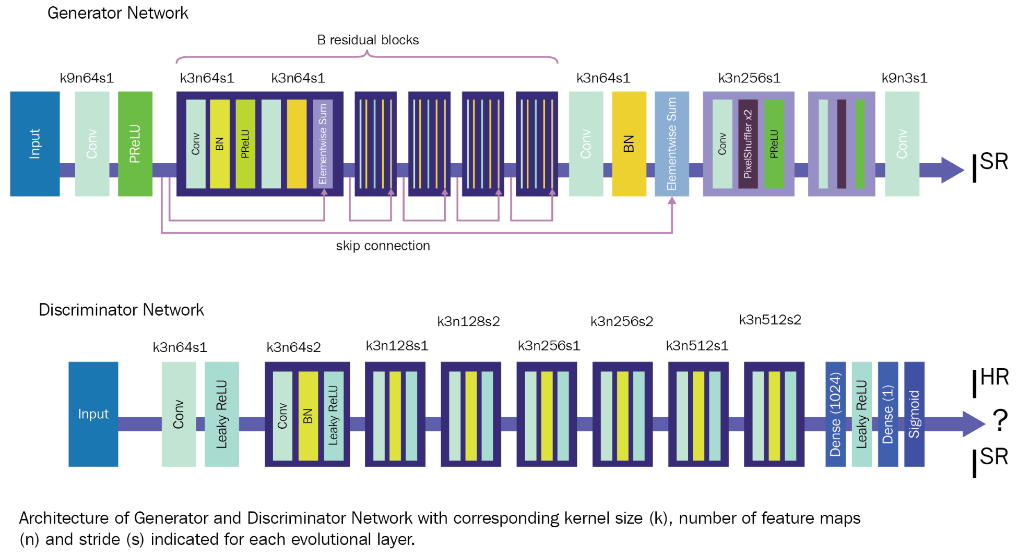
SRGAN

Slide 11
Training details
Adam Optimizer
Discriminator loss : Minimax loss
Generator loss:
Perceptual loss
Content loss + 0.001 * Adversarial Loss
Content loss :
Mean Squared Error (MSE) loss : Pixel-Wise loss
VGG loss : Based on feature maps from layers of VGG19 model

Slide 12
Per-Pix Loss
Stands for “Perceptual and Pixel” qualities of image
Per-Pix loss = w1 * MSE loss + w2 * VGG loss + 0.001 * Adversarial Loss
During Training: (Each step is training over a mini-batch)
Steps 1 – 15000 : w1 = 10 , w2 = 1
Steps 15000 – 20000 : w1 = 10, w2 = 10
Steps 20000 – 35000 : w1 = 1, w2 = 10
Note : Actual weightage of VGG loss is “w2 * 0.006” and should be less than MSE

Slide 13
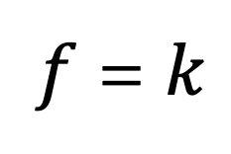

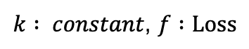
Intuition behind Per-Pix Loss
Change the parameters vector direction
VGG loss used for fine-tuning to capture object edges
MSE LOSS
$$\hat{∇f}$$
$k : constant$, $f :Loss$
$f$ = $k$
VGG LOSS
Figure : Parameter Vectors (due to losses addition)
Figure : Gradients

Slide 14
Training and Deployment Infrastructure
Training:
Google Colab
Google AI Platform Deep learning VM
Deployment:
Google AI platform

Slide 15






Workflow
Train model in Colab
GitHub
Make Inferences from Application through REST API
Store on Google Drive
Port Forwarding
Build model with TensorFlow
Deploy model on
AI Platform
Store on Google
Storage
Train model in Deep Learning VM
(AI Platform)
Credits : Designed by me

Slide 16
More specifics of coding
GPU training – Onedevice and MirroredStrategy
For faster training
TensorBoard
For visualization

Slide 17
Results of project
Evaluation criteria:
Pixel quality - through PSNR value
Perceptual quality - through human perception
Texture quality-
Advantage of using GANs since it uses adversarial loss

Slide 18
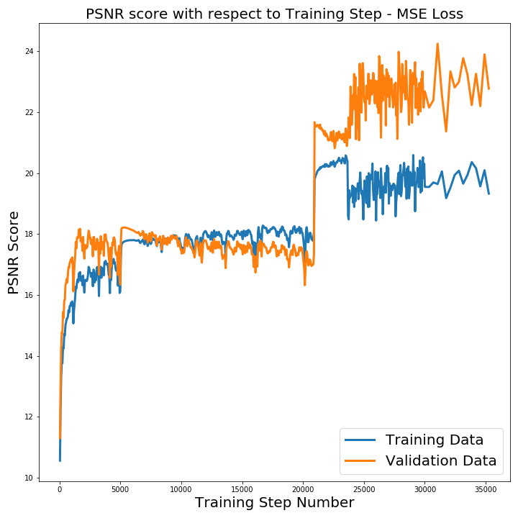
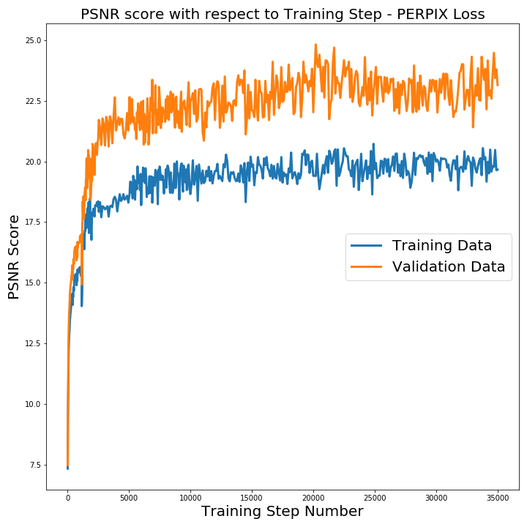
Pixel quality evaluation
Figure 1: PSNR across training steps for MSE trained model
Figure 2: PSNR across training steps for PERPIX trained model
Note: Training scores are only on part of training data, so take it as a grain of salt

Slide 19
Pixel quality comparison with SRGAN paper
Slightly higher PSNR with PERPIX due to preserving of PSNR with MSE loss component
Results are in right direction but require further training
Set5
 | MSE | VGG54 | PERPIX
SRGAN (paper) | 30.64 | 29.40 | N/A
SRGAN (In this project) | 26.53 | N/A | 26.57
Set14
 | MSE | VGG54 | PERPIX
SRGAN (paper) | 26.92 | 26.02 | N/A
SRGAN (In this project) | 23.77 | N/A | 23.92
Figure 1: Comparison of PSNR values on Set5 dataset
Figure 2: Comparison of PSNR values on Set14 dataset

Slide 20
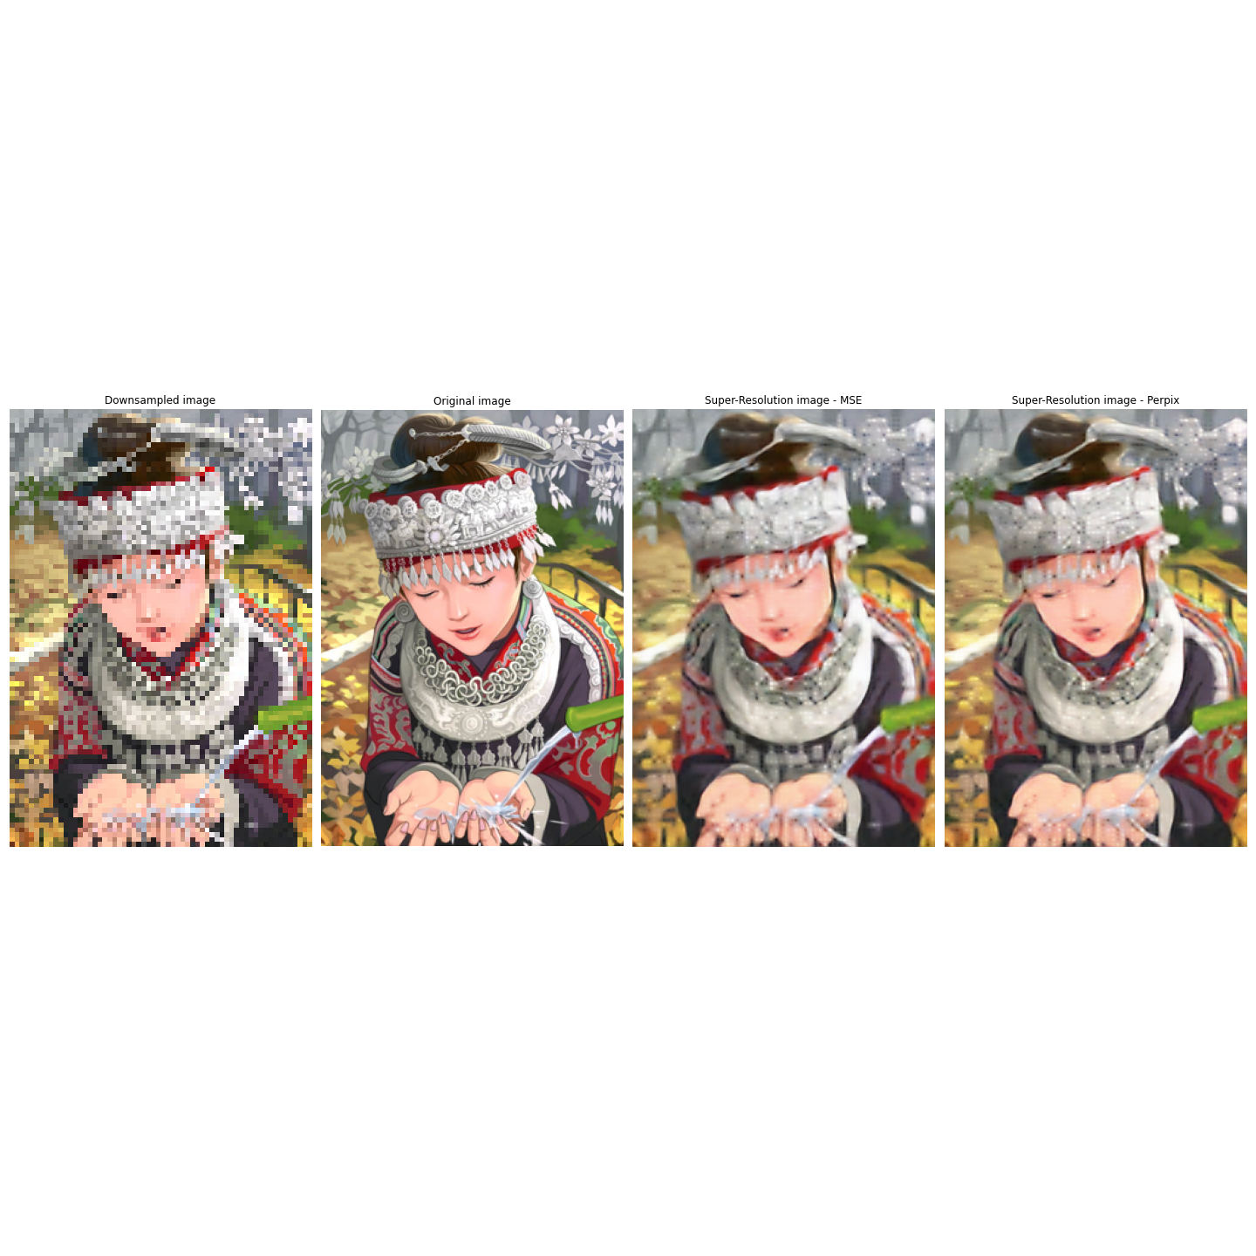
Perceptual quality evaluation
Figure : Comparison of down-sampled, real and output images of MSE, PERPIX trained models

Slide 21
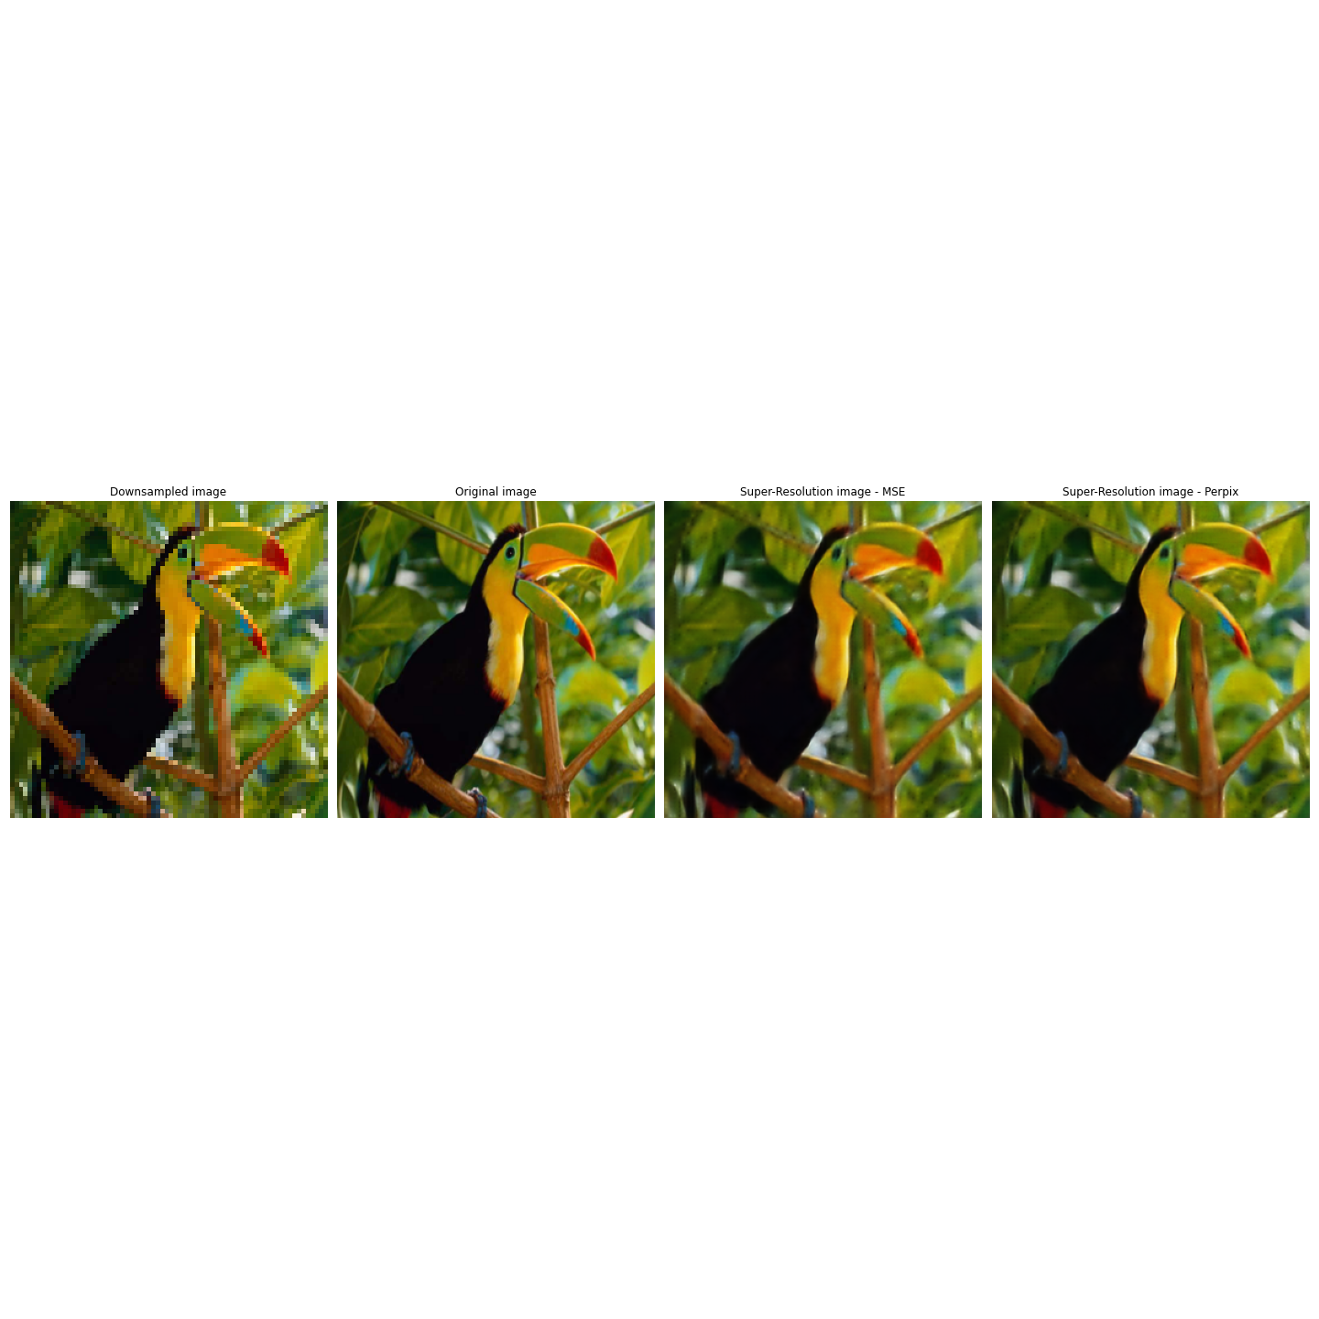
Perceptual quality evaluation
Figure : Comparison of down-sampled, real and output images of MSE, PERPIX trained models

Slide 22

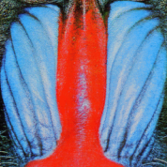


Perceptual quality (close observation)
Down-sampled
Original
Super-resolved with MSE loss
Super-resolved with Perpix loss
Figure : Comparison of down-sampled, real and output images of MSE, PERPIX trained models
Only minute change
Requires further training

Slide 23
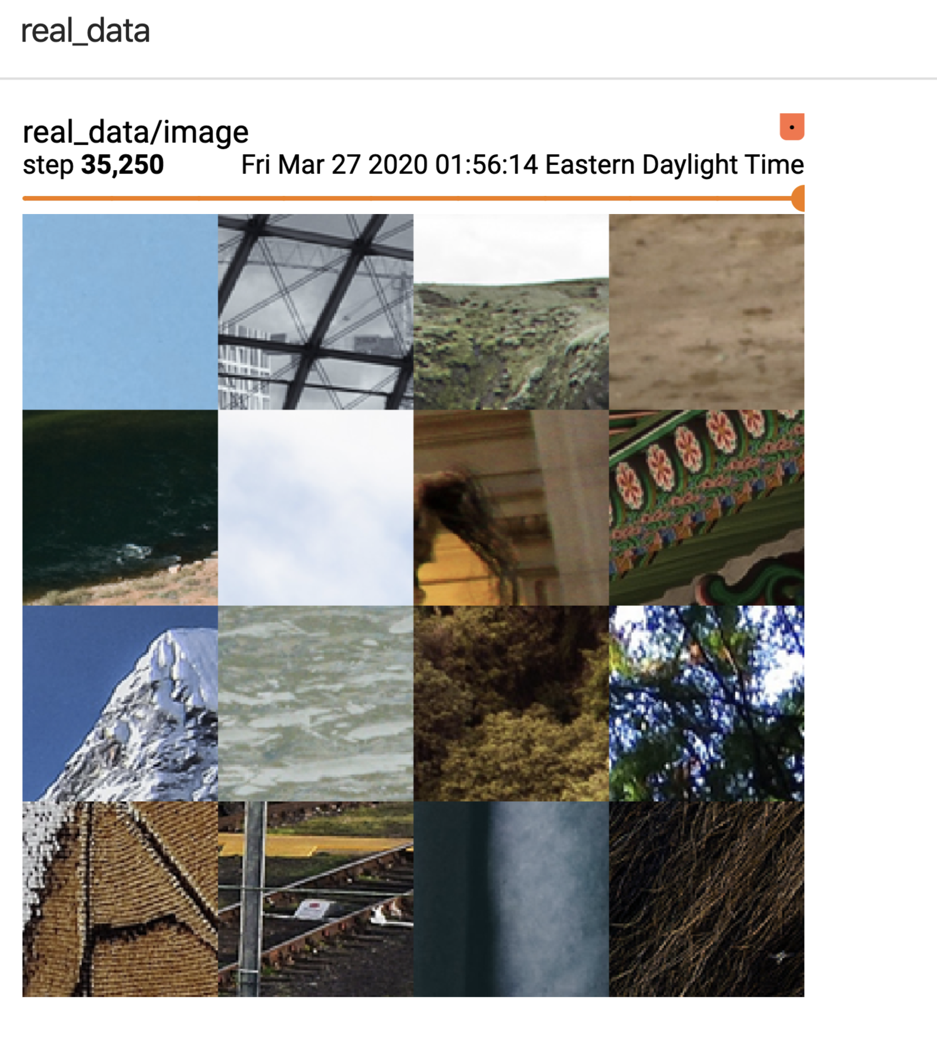
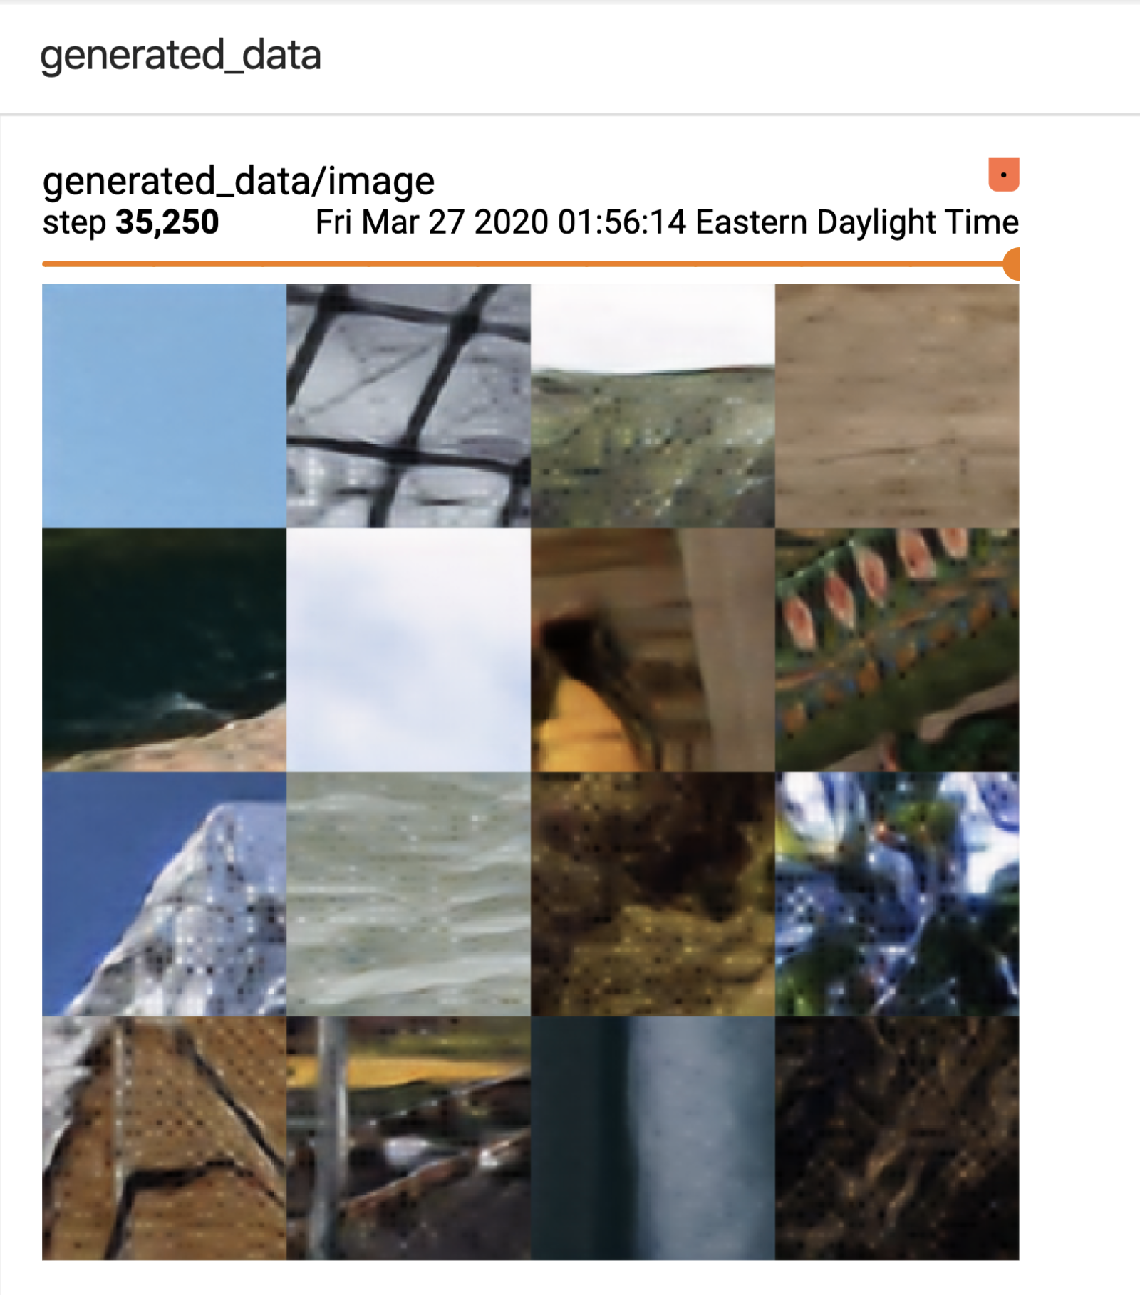
Perceptual quality – MSE (close observation)
Figure 1: Real images
Figure 2: Generated images from MSE trained model

Slide 24
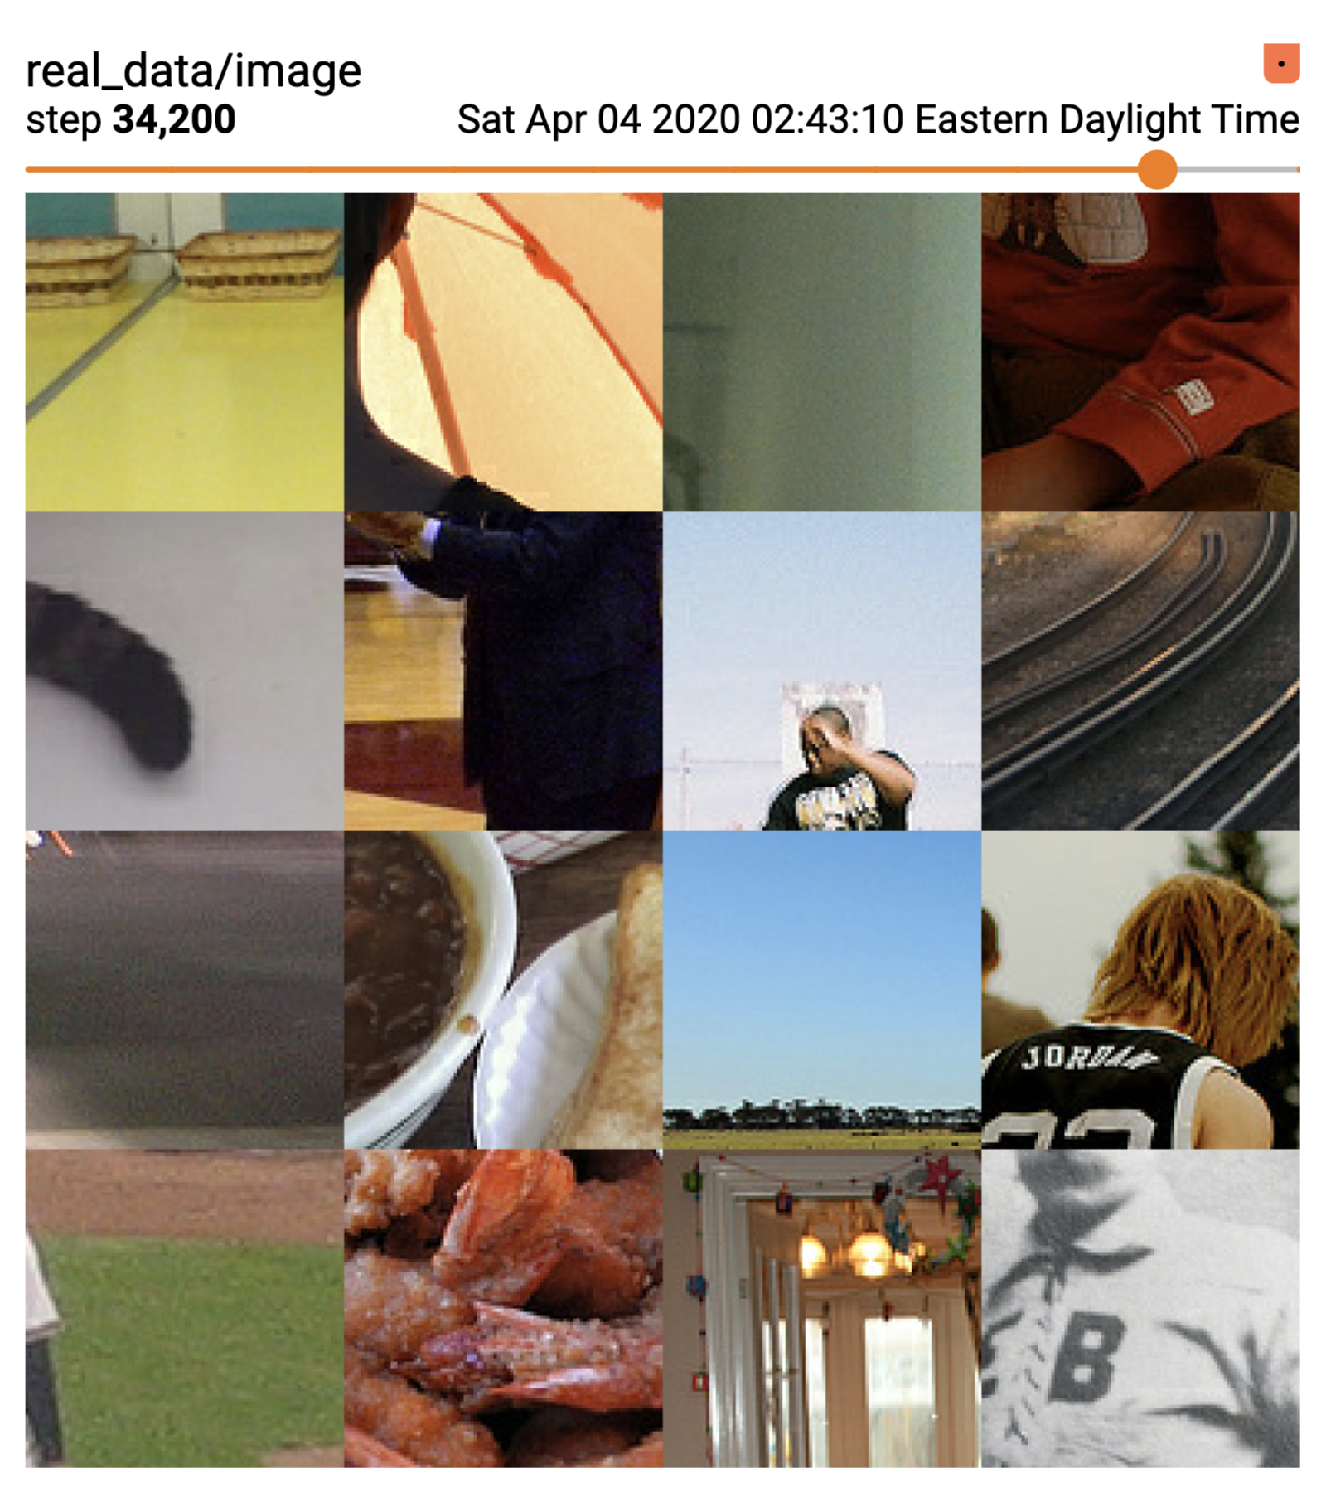

Perceptual quality-PERPIX(close observation)
Figure 1: Real images
Figure 2: Generated images from PerPix trained model

Slide 25


Super-resolution of Faces
Original Faces
Super-resolved Faces with PERPIX model

Slide 26
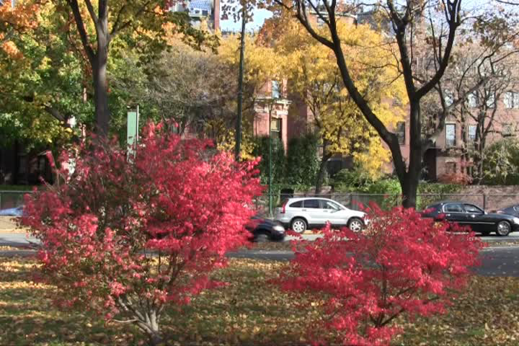

Super-resolution of Videos
Original Video
Super-resolved Video with PERPIX model

Slide 27
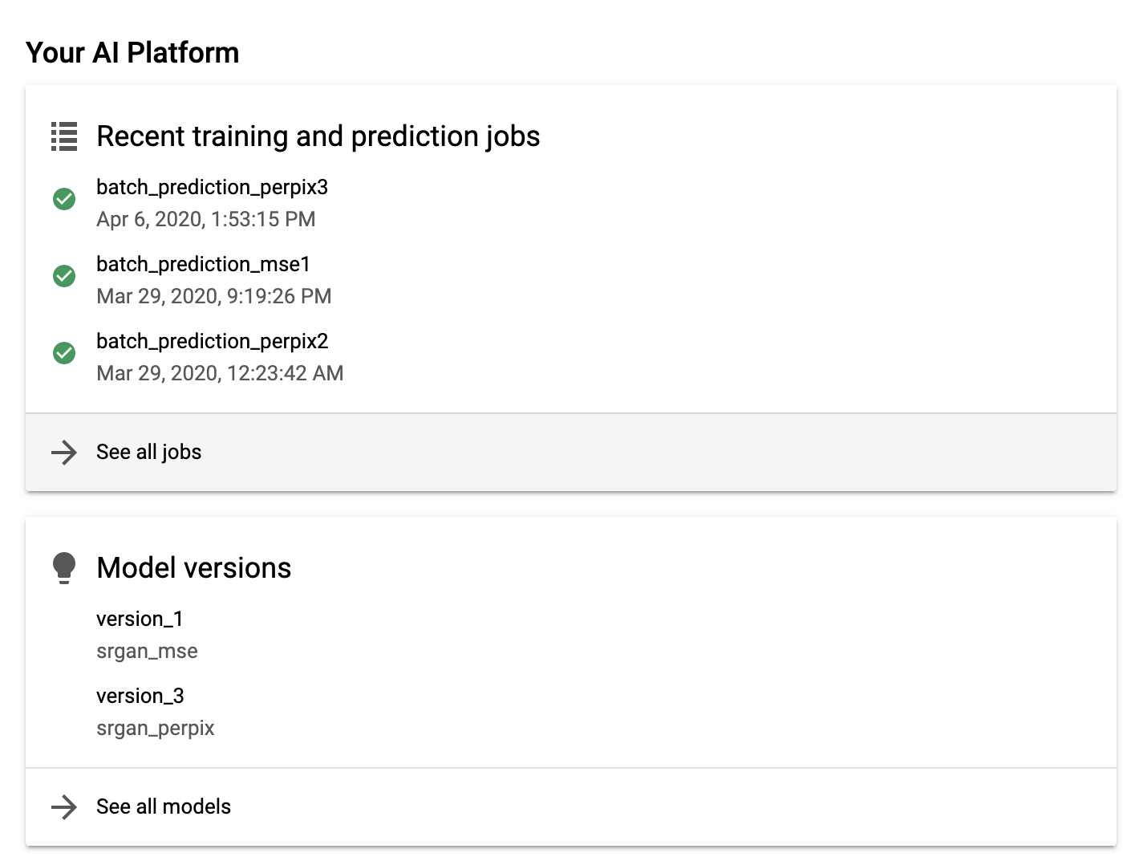
Deployment details
Deployed Models

Slide 28
Summary
In phase 1, SRGAN model was implemented and trained for few iterations
In phase 2, trained and deployed the model using Google cloud AI platform
Specifically, GPU training along with TensorBoard to interpret results
Experiments with weights in “ PERPIX loss ”
Did inferences on Faces, videos, and comparison with SRGAN paper results
Open-CV ( python )

Slide 29
Ways of improvement
Improving gradient behavior
Adding new loss component to reach higher PSNR
New metric that reflect perceptual quality

Slide 30
Challenges
Working with variations of new loss ( PERPIX )
Writing custom code
saver program to save best model besides latest checkpoint
Integrating different TF APIs or modules
TF data, Estimator API, TensorBoard, GPU training

Slide 31
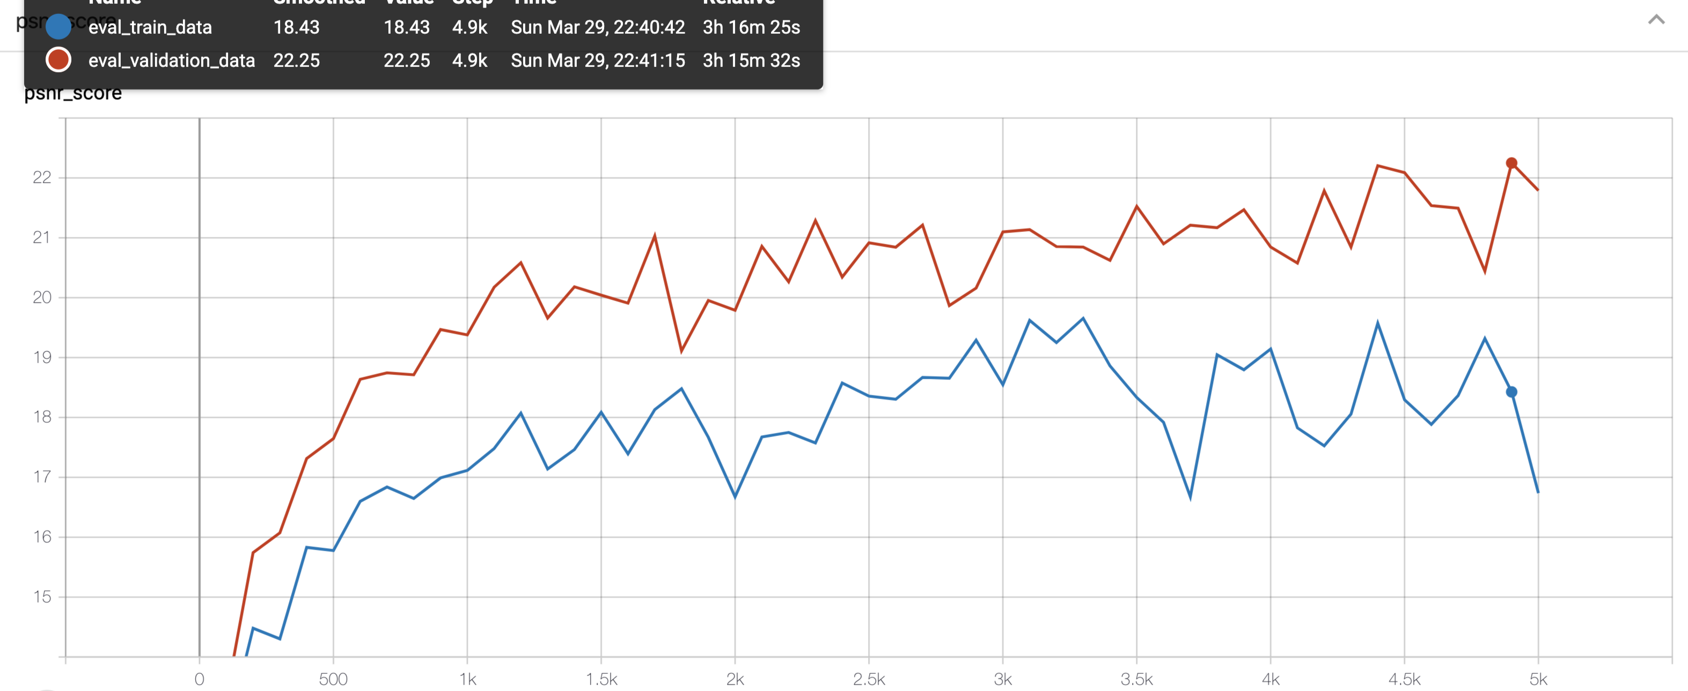
Further Work
Entirely different loss function
Doesn’t include either MSE or VGG loss
PSNR SCORE
Training steps
Figure : PSNR with new loss ( sneak peek )

Slide 32
“Thank You”

Slide 33
References
I.Goodfellow, J.Pouget-Abadie, M.Mirza, B.Xu, D.Warde-Farley, S. Ozair, A. Courville, and Y. Bengio. Generative adversarial nets. In Advances in Neural Information Processing Systems (NIPS), pages 2672–2680, 2014.
C. Ledig, L. Theis, F. Husza ŕ , J. Caballero, A. Cunningham, A. Acosta, A. P. Aitken, A. Tejani, J. Totz, Z. Wang et al., “Photo-realistic single image super-resolution using a generative adversarial network,” in CVPR, 2017.
Zhihao Wang, Jian Chen, Steven C.H. Hoi, Fellow, "Deep Learning for Image Super-resolution: A Survey", IEEE, 2020.
C.Y. Yang, C. Ma, and M.H. Yang. Single-image super-resolution:A benchmark. In European Conference on Computer Vision (ECCV),pages 372–386. Springer, 2014.
Agustsson, Eirikur and Timofte, Radu. “NTIRE 2017 Challenge on Single Image Super-Resolution: Dataset and Study”, The IEEE Conference on Computer Vision and Pattern Recognition (CVPR) Workshops, July 2017.

